Slide 1
Review III Presentation
Title: Intelligent Approaches for Fault Forecasting in Cars
Student Name: Charan N
Research Guides: Mr. Alwin Joseph, Dr. Ramesh
Date: 22/09/2023

Slide 2
Introduction
Vehicle technology has significantly advanced in the automotive sector in recent years, resulting in better performance, higher comfort, and more safety measures.
Modern automobiles have evolved into exceedingly complicated machines with the integration of intricate technological systems and cutting-edge software.
The detection and diagnosis of problems in automotive systems, however, presents a significant barrier as a result of this complexity.

Slide 3
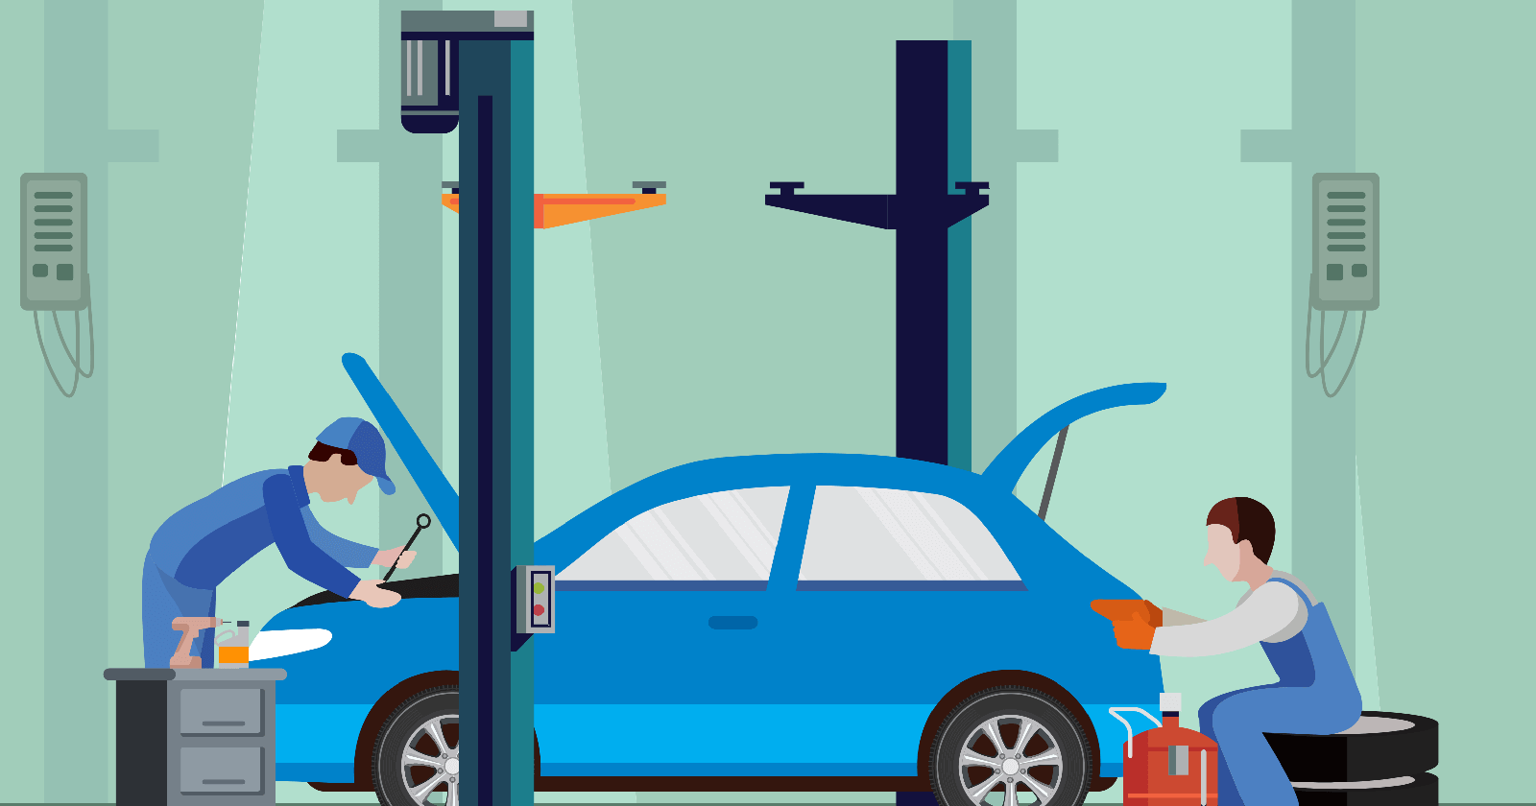
Objective:
Researchers and industry experts have made significant progress in developing predictive models for identifying and anticipating faults in automobiles by leveraging advanced data analysis techniques and machine learning algorithms.
The advantages of fault prediction in automobiles are substantial. It can improve vehicle safety by anticipating potential hazards and taking preventative measures.
It can also lower maintenance costs by enabling predictive maintenance, which schedules repairs and replacements based on the predicted likelihood of failure. It can also improve customer satisfaction by reducing unexpected breakdowns and increasing overall vehicle reliability.

Slide 4
Problem Statement
Creating a machine learning-based solution for failure prediction in cars is the issue at hand.
The objective is to develop a prediction model that predict whether the car is going to get fault or not
Also to predict the price of the cars which is related to fault prediction

Slide 5
Research Objective:
This research paper's goal is to investigate the importance of fault detection in automotive systems and the approaches used to efficiently detect and mitigate defects.
We hope to contribute to current efforts to improve vehicle safety and reliability by addressing this important factor.
To protect the safety of passengers and other road users, it is crucial to identify and fix automotive problems.
Mechanical parts, electrical systems, sensors, and programming errors are only a few of the many potential sources of faults.
These flaws can have significant repercussions if identified or unfixed, ranging from simple annoyances to potentially fatal accidents.

Slide 6
Datasets Involved
Dataset | Description
Vehicle power transmission system dataset | Contains data related to vehicle power transmission systems, including attributes such as acoustic signals and weather data
Automobile engine dataset | Consists of data collected from automobile engines
LNG engine city bus dataset | Includes attributes such as bus maintenance records, bus daily schedule data.
Intelligent connected vehicle dataset | Includes various data sources such as sensor data, vehicle performance indicators, and external weather data.
CAN-BUS dataset | Includes attributes such as engine speed, brake pressure, and coolant liquid levels.
Bus maintenance system dataset | maintenance records of buses, providing information about repairs and faults
Bus daily schedule system dataset | Daily schedules of buses, including information about routes and timing
Weather data | Weather-related information such as temperature, humidity, and precipitation
Field claim warranty data | Warranty claim data related to automobile parts, which is used for reliability analysis
Used Cars Dataset | Dataset with some used cars details
Cars spare parts Data | Details of car spare parts changed

Slide 7
Algorithms Used
Model Name | Accuracy | Result
XGBRegressor | Mean Squared Error: 0.5039888125580769 | Depends on context
Random Forest Classifier | 100.00% | Overfitted
Linear Regression | R-squared (R2): 0.0625986760112035 | Depends on context
Vector Machine (SVM) | 96.19% | Recommended
Logistic Regression | 95.96% | Recommended

Slide 8
Research Gap
Fault Prediction
Parts Reliability
Maintenance
Predicting Price
Dataset Used:
Used Cars Dataset
Car Prices Dataset
Car Spare Parts Dataset

Slide 9
Conclusion
After comparing all the models and it’s accuracy I came to a conclusion that the combination of machine learning algorithms such as Random Forest Classifier, Linear Regression, Logistic Regression, SVM gives good solution.
The final model predicts whether the car gets fault or not.
I have made the model which works by giving inputs by users, which helps in predicting the fault of new cars given by the user in the dataset.
Inputs mentioned here denotes features or column names of the dataset.
In this model the inputs are oil filter, engine oil, washer plug drain, dust filter, wheel alignment and balancing, air filter, fuel filter, spark plug, brake fluid, brake and clutch oil, transmission fluid, brake pads, clutch, coolant.
After finding the fault of the given car this project is also capable for predicting the selling price of the car.

Slide 10
Conclusion
To summarize, fault prediction in automobiles holds great promise for improving vehicle safety, reliability, and maintenance efficiency.
With continued advancements in machine learning, data analytics, and connected car technologies, we can expect further improvements in fault prediction models, resulting in safer and more reliable vehicles on the road.
With real-time data and machine learning techniques, dynamic and adaptive fault prediction models can continuously learn and improve their accuracy over time.

Slide 11


